Slide 1
Herein
Do I Exercise Myself
Acts 24:16

Slide 2
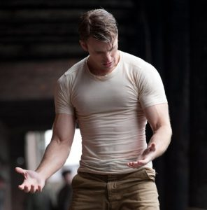


Spiritual Exercise

Slide 3

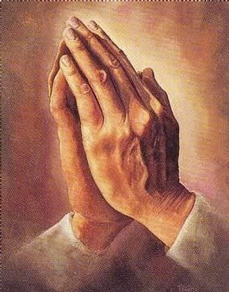
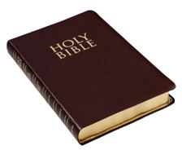

Slide 4
The Goal
A conscience void of offense toward God and men
A matter of conscience
Labor to keep alive in your breast that little spark of celestial fire called
conscience. George Washington
I love those who can smile in trouble, who can gather strength from
distress, and grow brave by reflection. 'Tis the business of little minds to
shrink, but they whose heart is firm, and whose conscience approves their conduct, will pursue their principles unto death. Leonardo Da Vinci

Slide 5
The Goal
A conscience void of offense toward God and men
A matter of conscience
The conscience is the little needle indicator on the dashboard of our mind that starts moving when you are tempted, and stays there when you sin anyway.
Joh 8:9 And they which heard it, being convicted by their own conscience, went out one by one, beginning at the eldest, even unto the last: and Jesus was left alone, and the woman standing in the midst.
1Ti 4:2 Speaking lies in hypocrisy; having their conscience seared with a hot iron;

Slide 6
The Goal
A conscience void of offense toward God and men
Void of offence
  A. Toward God
2Ti 1:3 I thank God, whom I serve from my forefathers with pure conscience, that without ceasing I have remembrance of thee in my prayers night and day;
Rom 9:1 I say the truth in Christ, I lie not, my conscience also bearing me witness in the Holy Ghost,
Sin is what offends God, and choosing sin makes our conscience to register offence before Him

Slide 7
The Goal
A conscience void of offense toward God and men
Void of offence
  A. Toward God
Hab 1:12 Art thou not from everlasting, O LORD my God, mine Holy One? we shall not die. O LORD, thou hast ordained them for judgment; and, O mighty God, thou hast established them for correction. 13 Thou art of purer eyes than to behold evil, and canst not look on iniquity: wherefore lookest thou upon them that deal treacherously, and holdest thy tongue when the wicked devoureth the man that is more righteous than he?

Slide 8
The Goal
A conscience void of offense toward God and men
Void of offence
  B. Toward men
2Co 4:1 Therefore seeing we have this ministry, as we have received mercy, we faint not; 2 But have renounced the hidden things of dishonesty, not walking in craftiness, nor handling the word of God deceitfully; but by manifestation of the truth commending ourselves to every man's conscience in the sight of God.
Php 1:9 And this I pray, that your love may abound yet more and more in knowledge and in all judgment; 10 That ye may approve things that are excellent; that ye may be sincere and without offence till the day of Christ;

Slide 9
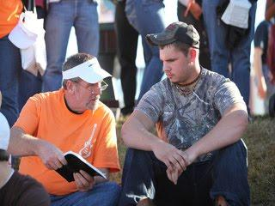
The Goal
A conscience void of offense toward God and men
Void of offence
  B. Toward men
In our conscience we must know that we are right with, or have at least done right by those around us in the sight of God.

Slide 10
Exercise
Directed
Strengthening specific areas
Php 4:13 I can do all things through Christ which strengtheneth me.
The paradox about spiritual exercise is that you are working to become weaker and more surrendered. If you are exercising to make yourself better at being a Christian you are doing it wrong.
2 Cor 12:9 And he said unto me, My grace is sufficient for thee: for my strength is made perfect in weakness. Most gladly therefore will I rather glory in my infirmities, that the power of Christ may rest upon me.

Slide 11
Exercise
Directed
Strengthening specific areas
Psalm 27:14 Wait on the Lord: be of good courage, and he shall strengthen thine heart: wait, I say, on the Lord.
Eph 3:16 That he would grant you, according to the riches of his glory, to be strengthened with might by his Spirit in the inner man;
2Ti 4:17 Notwithstanding the Lord stood with me, and strengthened me; that by me the preaching might be fully known, and that all the Gentiles might hear: and I was delivered out of the mouth of the lion.

Slide 12
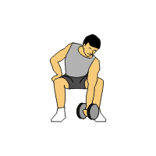
Exercise
Directed
Strengthening specific areas
Push and Pull
  Say yes to right things
  Do whatever it takes to know God!
  Php 3:8 Yea doubtless, and I count all things but loss for the excellency of the knowledge of Christ Jesus my Lord: for whom I have suffered the loss of all things, and do count them but dung, that I may win Christ,9 And be found in him, not having mine own righteousness, which is of the law, but that which is through the faith of Christ, the righteousness which is of God by faith:10 That I may know him, and the power of his resurrection, and the fellowship of his sufferings, being made conformable unto his death;

Slide 13
Exercise
Directed
Strengthening specific areas
Push and Pull
  Say yes to right things
  The choices that you make on how you spend your time reveal what or who you are devoted to.
  Pro 18:1 Through desire a man, having separated himself, seeketh and intermeddleth with all wisdom.

Slide 14
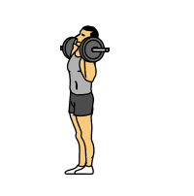
Exercise
Directed
Strengthening specific areas
Push and Pull
  Say no to sin
  Rom 13:14 But put ye on the Lord Jesus Christ, and make not provision for the flesh, to fulfil the lusts thereof.
  Eph 4:31 Let all bitterness, and wrath, and anger, and clamour, and evil speaking, be put away from you, with all malice: 32 And be ye kind one to another, tenderhearted, forgiving one another, even as God for Christ's sake hath forgiven you.

Slide 15
Exercise
Directed
Strengthening specific areas
Push and Pull
  Say no to sin
  Col 3:1 If ye then be risen with Christ, seek those things which are above, where Christ sitteth on the right hand of God. 2 Set your affection on things above, not on things on the earth. 3 For ye are dead, and your life is hid with Christ in God. 4 When Christ, who is our life, shall appear, then shall ye also appear with him in glory.5 Mortify therefore your members which are upon the earth; fornication, uncleanness, inordinate affection, evil concupiscence, and covetousness, which is idolatry:

Slide 16
Exercise
Effort
Repetitions
The more you become accustomed to choosing right, the more the habit is formed and is continued.
Do the hard things
The more resistance, the more can be accomplished.

Slide 17

Exercise
Effort
Do the hard things
2Ti 2:1 Thou therefore, my son, be strong in the grace that is in Christ Jesus. 2 And the things that thou hast heard of me among many witnesses, the same commit thou to faithful men, who shall be able to teach others also. 3 Thou therefore endure hardness, as a good soldier of Jesus Christ. 4 No man that warreth entangleth himself with the affairs of this life; that he may please him who hath chosen him to be a soldier. 5 And if a man also strive for masteries, yet is he not crowned, except he strive lawfully.
Don’t give up what you want most, for what you want in the moment.

Slide 18
Consistency
Always
The flesh is limited and quickly quits
If you are feeling tired and looking for some “me time” you are not in Christ and walking in the power of His might
Psa 73:26 My flesh and my heart faileth: but God is the strength of my heart, and my portion for ever.
The spirit doesn’t need to stop to rest
A. Rest for the spirit is a place

Slide 19
Consistency
Always
The spirit doesn’t need to stop to rest
A. Rest for the spirit is a place
Heb 4:10 For he that is entered into his rest, he also hath ceased from his own works, as God did from his. 11 Let us labour therefore to enter into that rest, lest any man fall after the same example of unbelief.
B. Rest from spiritual exercise is an opening for sin
The idea that God is ok with anything less than 100% is of Satan

Slide 20
Consistency
Always
We must be like Jesus
Joh 8:28 Then said Jesus unto them, When ye have lifted up the Son of man, then shall ye know that I am he, and that I do nothing of myself; but as my Father hath taught me, I speak these things. 29 And he that sent me is with me: the Father hath not left me alone; for I do always those things that please him.
A ship on the sea will never avoid the waves, but a helm guided with a purposed hand is never far off course.
Joh 5:30 I can of mine own self do nothing: as I hear, I judge: and my judgment is just; because I seek not mine own will, but the will of the Father which hath sent me.

